Slide 1
Presentation of
Moon Modeler
Teacher:
Soheila Ashkzari
Team:
Mohammad Azqandi
Mahin Hossein-zade
Iraj Qaraei
Ali Mirzaei

Slide 2
What is data modeling ?
Why we use it ?
01
02
What is data modeling tools?
What is moon modeler ?
03
04
Overview of User Interface
Concepts and features
05
Projects, ERdiagrams, Database connections, Reverse engineering, Forward engineering, Database reporting, Export to PDF
06

Slide 3
What is data modeling?
Why we use it?
Data modeling is a technique used to define and organize your business processes. It allows you to create a visual description of your business by analyzing, understanding and clarifying your data requirements and how they underpin your business processes.
To really understand what data modeling is, you have to dig down and look at the specific benefits it delivers. Here are the four main benefits of effective data modeling:
1. Cut costs and achieve faster time to value
2. Understand and improve business processes
3. Reduce complexity and risk
4. Improved collaboration

Slide 4










What is data modeling tools?
Here is a list of the best data modeling tools:
1) ER/Studio
2) DbSchema
3) ConceptDraw
4) Erwin Data Modeler
5) Archi
6) Moon Modeler
7) SQL DBM
8) Toad Data Modeler
9) PgModeler
10) GenMyModel
…

Slide 5

What is moon modeler?
Moon Modeler is a data modeling tool for MongoDB, PostgreSQL, MariaDB, MySQL, SQLite, Mongoose and GraphQL. The software belongs to the schema design tools category and can be used to model hierarchical database structures. Embedded documents can be displayed inside MongoDB collections, JSON structures in MariaDB, MySQL, PostgreSQL or SQLite entity relationship diagrams (ERD). Links and relationships between two collections/tables are represented by lines.

Slide 6
Moon Modeler Features | Basic | Professional
Supported platforms | + | +
MongoDB | + | +
Mongoose | + | +
PostgreSQL | + | +
MariaDB | + | +
MySQL | + | +
SQLite | + | +
GraphQL | + | +
Data modeling | + | +
ER diagrams and visual schema design | + | +
Support for platform specific objects | + | +
Visualization of nested/embedded objects | + | +
Automatic creation of foreign keys | + | +
Default values for a project | + | +
Custom data types for a project | + | +
User interface | + | +
Dark and light theme | + | +
Custom colors for items on ER diagrams | + | +
Undo | + | +
Find an object | + | +
Objects filtering | + | +
Automatic object resizing, lock dimensions | + | +
Multiple objects alignment and resizing | + | +
Multiple line modes | + | +
Multiple display modes | + | +
Optional display of embedded objects on diagram | + | +
Optional display of database/schema name | + | +
Optional display of estimated size | + | +
Optional display of relationship captions | + | +
Comparison of editions
Moon Modeler Features | Basic | Professional
Zoom | + | +
Subdiagrams | + | +
Subdiagrams for objects in a subject area | - | +
Subdiagram creation for schema/database | - | +
Code generating | + | +
Generating project script | + | +
Generating subdiagram script | - | +
Settings for output formatting (relational databases) | + | +
Order items (relational databases) | + | +
Reporting | + | +
Export to PDF | + | +
Export subdiagram to PDF | - | +
Interactive HTML reports | - | +
Multiple styles for HTML reports | - | +
Visualization of existing structures | + | +
Basic database connections & reverse engineering (RE) | + | +
Secure SSH connection & reverse engineering | - | +
Secure SSL/TLS connection & reverse engineering | - | +
MongoDB Atlas, Cosmos DB, Heroku Postgres… | - | +
Import from SQLite files | + | +
Import from GraphQL files or URL | + | +
Pricing | + | +
List price | 99 USD | 149 USD

Slide 7
Overview of user interface
Moon Modeler user interface includes:
Projects
Connections
Panels
Settings & Themes
Display modes
Line modes

Slide 8
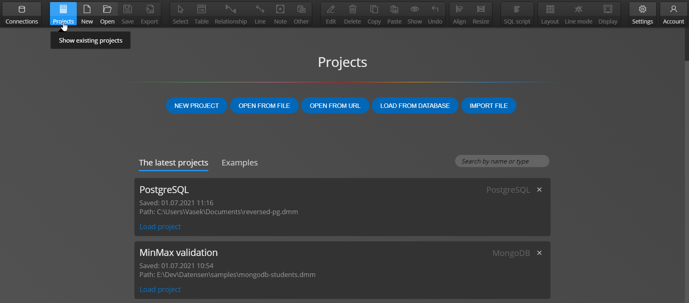
Projects

Slide 9
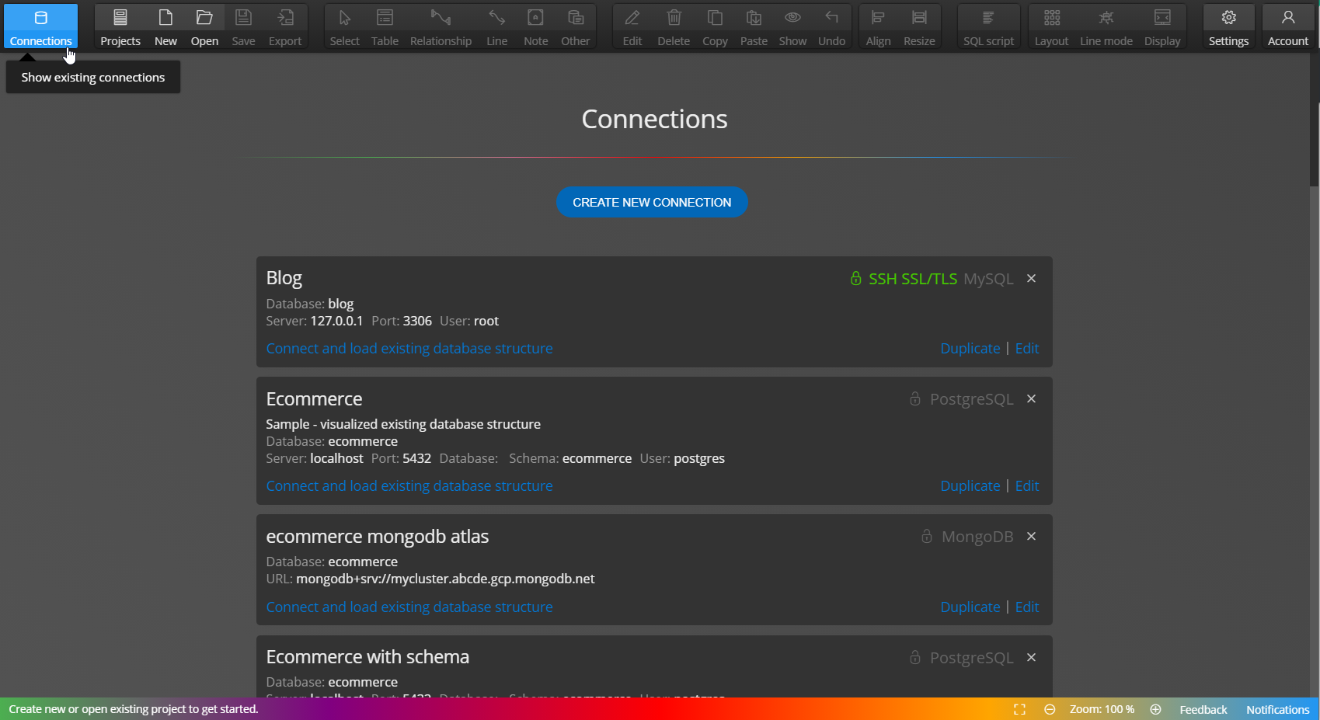
Connections

Slide 10
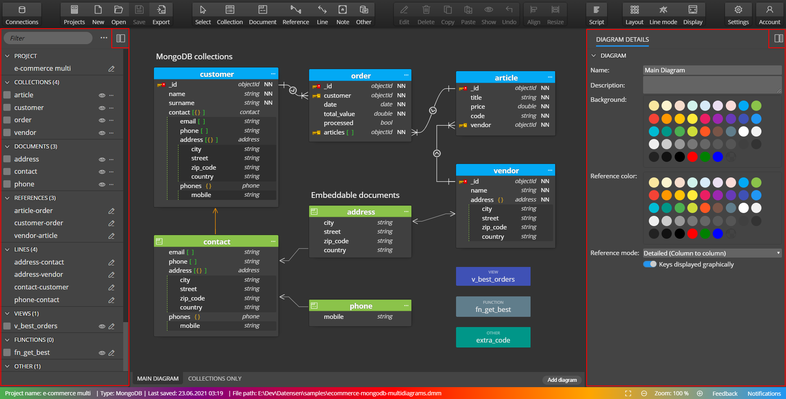
Panels

Slide 11
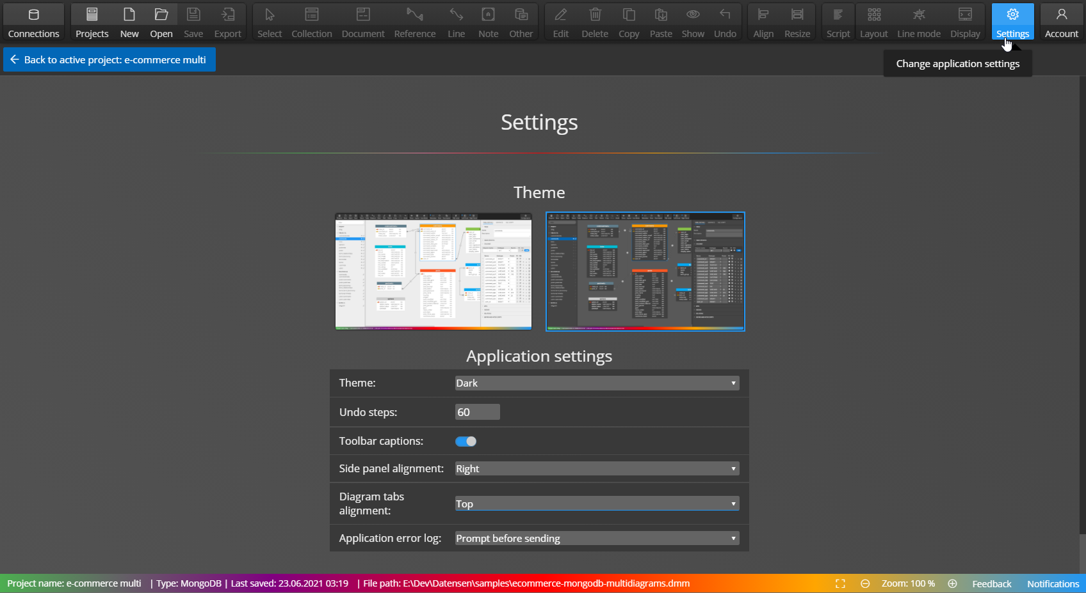
Settings & Themes

Slide 12
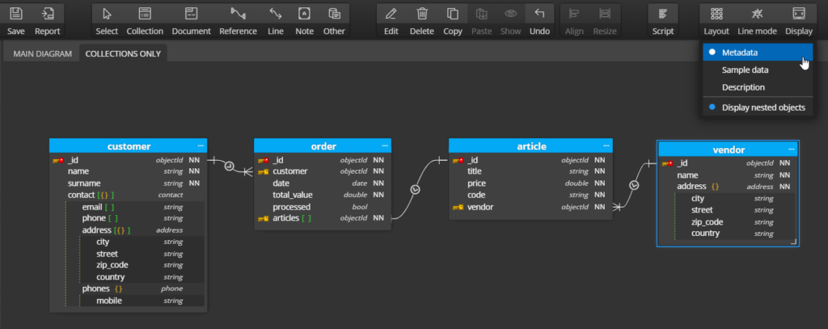
Display modes
Metadata – datatypes

Slide 13
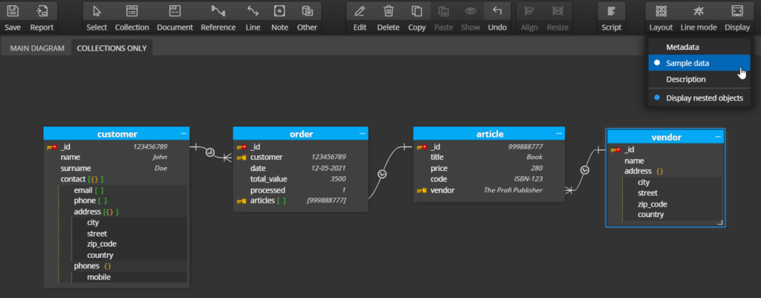
Display modes
Sample data

Slide 14
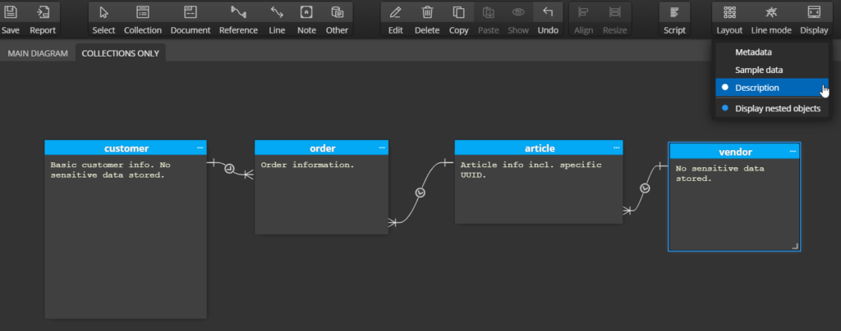
Display modes
Descriptions

Slide 15
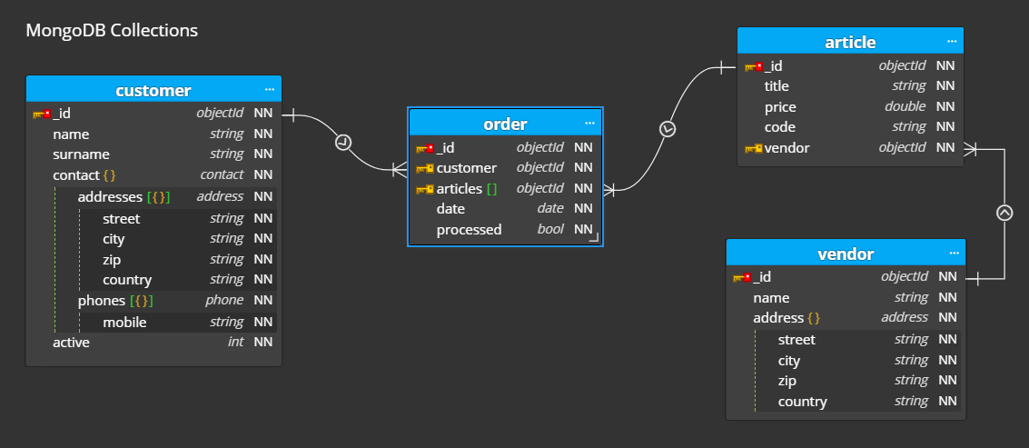
Line modes
Detailed

Slide 16
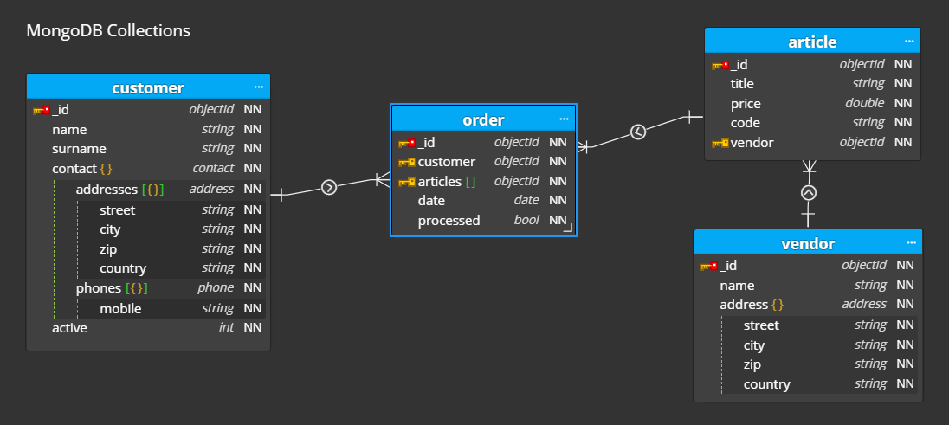
Line modes
Simple

Slide 17
Concepts and features

Slide 18
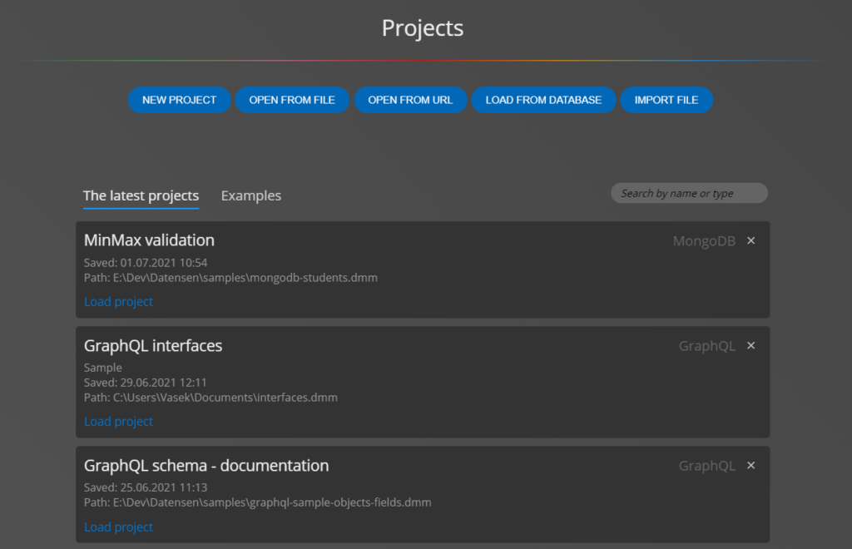
Projects in Moon Modeler
You can save your database structures and schema designs in Moon Modeler into projects.
On the project overview page, you can search projects by name or platform, quickly find the platform for which the project was created, and also view examples on a separate tab.

Slide 19
Projects in Moon Modeler
What does the Project contain?
List of all objects that exist in the structure
Main diagram, in which certain objects can be shown or hidden
Additional subdiagrams that are used to visualize a specific group of objects
Creating projects
You can create a completely new project and start creating a database design or schema design from scratch
It is also possible to load an existing project from a file or from a URL.
For MongoDB, PostgreSQL, MySQL, and MariaDB, you can create a new project by reverse engineering from an existing database.
For SQLite and GraphQL, you can create a new project by importing from a file.

Slide 20
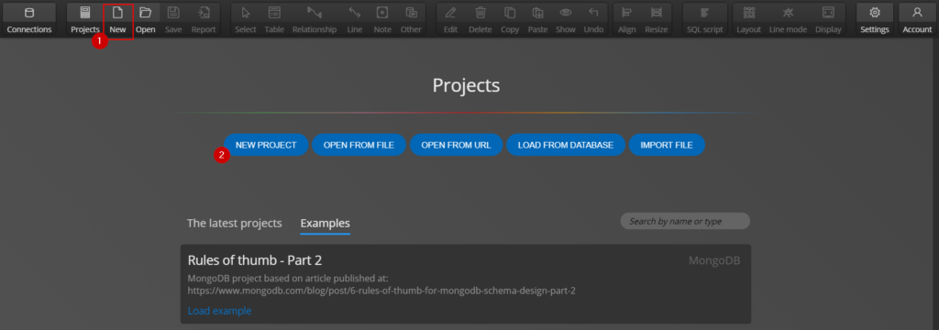
Projects in Moon Modeler
New project
To create a completely new project, go to the Projects page and click on New project, or click on the New button on the main toolbar. A new dialog will appear. Select the target platform, enter a project name, and then click Create new project.

Slide 21
Projects in Moon Modeler
Open an existing project from a file
This is the classic way to open a project from an existing file. Just select the file with the *.dmm extension.

Slide 22
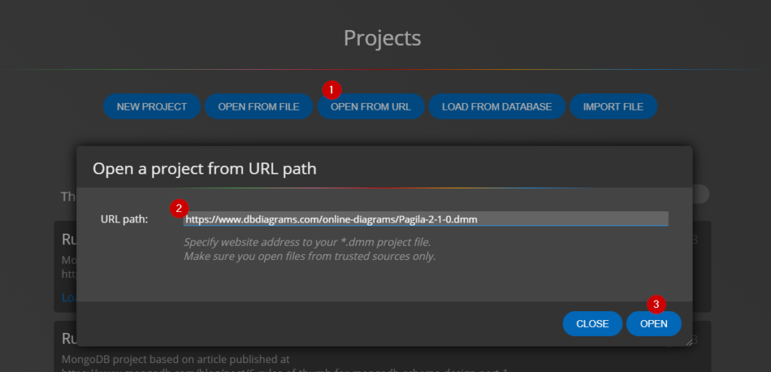
Projects in Moon Modeler
Loading a project from a URL
This option is useful, for example, in a tutorial where the author of the project shares the URL where the database design is stored.
Students can then open the file, modify it and save a copy of it on their computer. To load the project from the URL, click Open from URL on the Projects page. Type the URL and click Open.

Slide 23
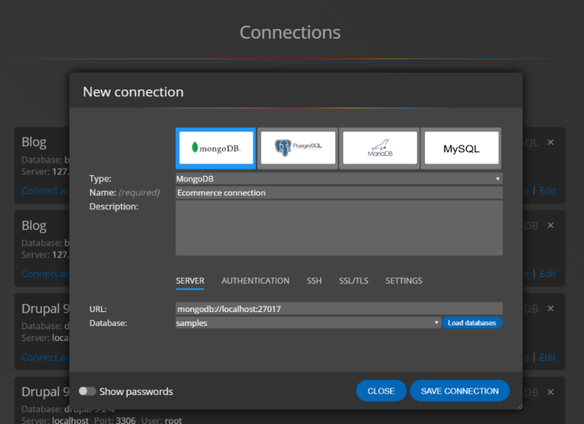
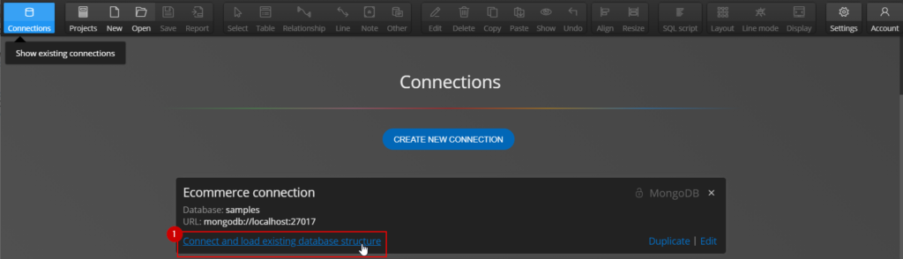
Creating a new database connection
and reverse engineering
Moon Modeler allows you to create new projects and ER diagrams from existing database structures. To visualize existing databases, you must create a database connection. Click on the Connections button on the main toolbar and then click on the Create new connection button.
Select the target platform and set the options for the database connection. Save everything using the Save connection button.
Projects in Moon Modeler
Then click Connect and load existing database structure.

Slide 24
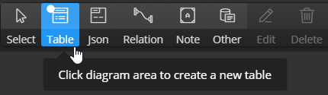
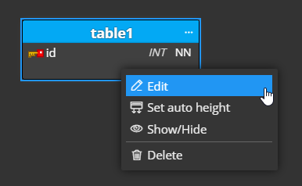
Adding tables and columns to the project and diagram
creating ER diagrams
in Moon Modeler

Slide 25
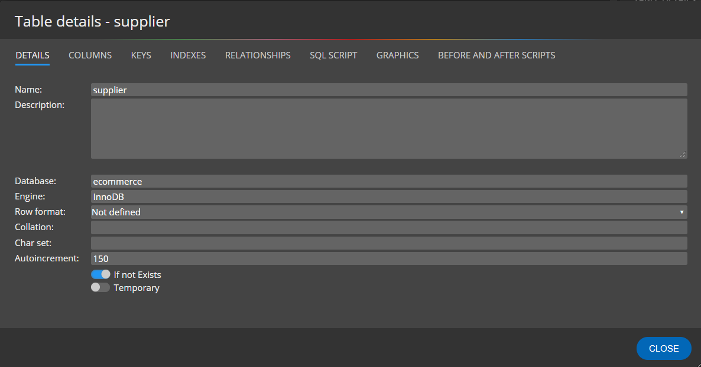
Table properties
creating ER diagrams
in Moon Modeler
Details

Slide 26
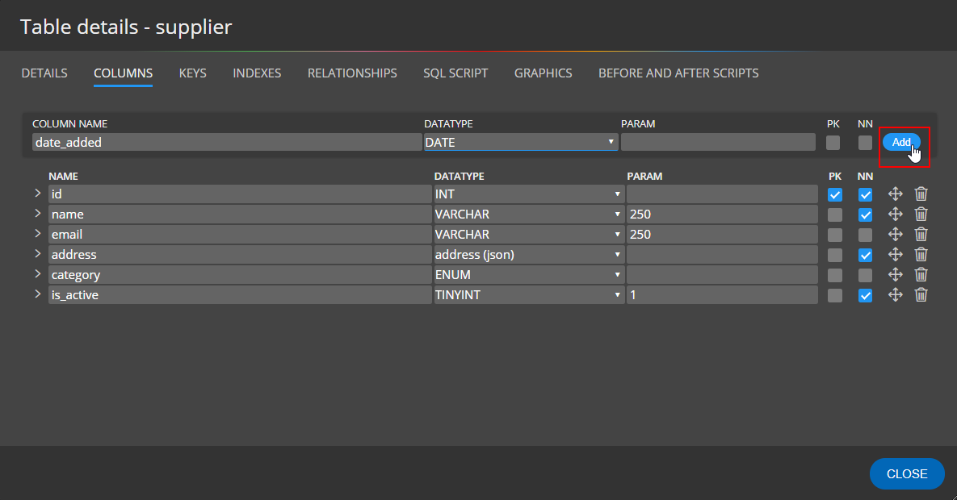
Table properties
creating ER diagrams
in Moon Modeler
Details

Slide 27
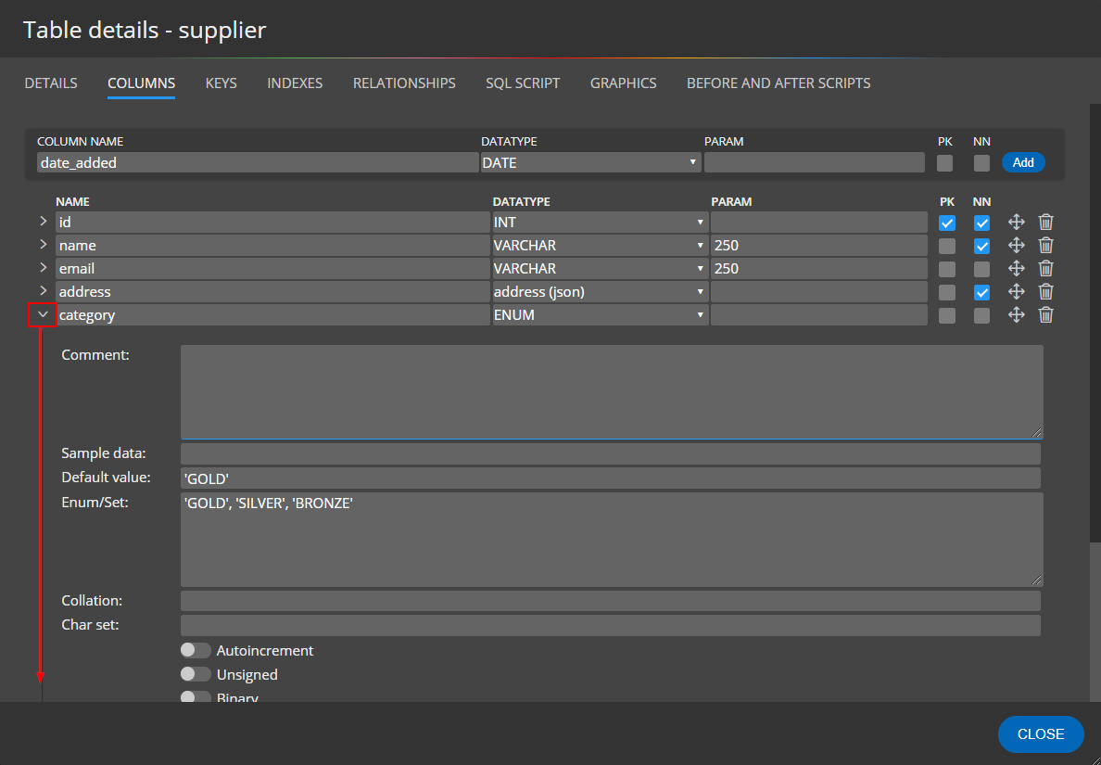
Table properties
creating ER diagrams
in Moon Modeler
Column specifics

Slide 28
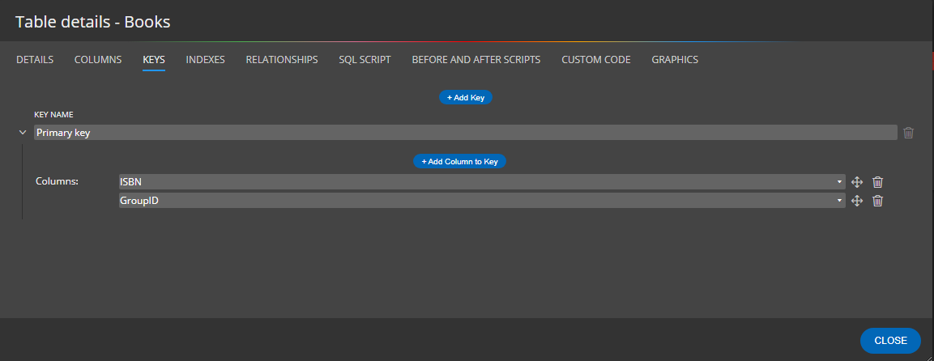
Table properties
creating ER diagrams
in Moon Modeler
Keys

Slide 29
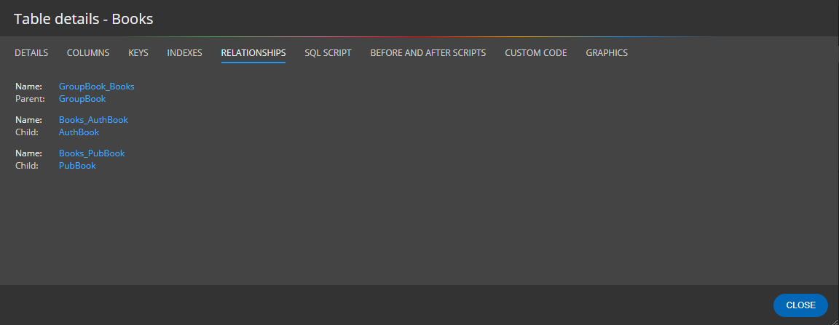
Table properties
creating ER diagrams
in Moon Modeler
Relationships

Slide 30
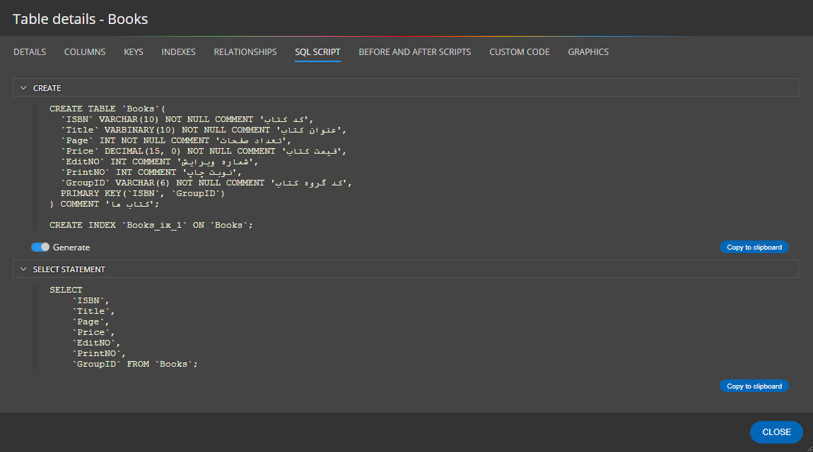
Table properties
creating ER diagrams
in Moon Modeler
SQL Script

Slide 31
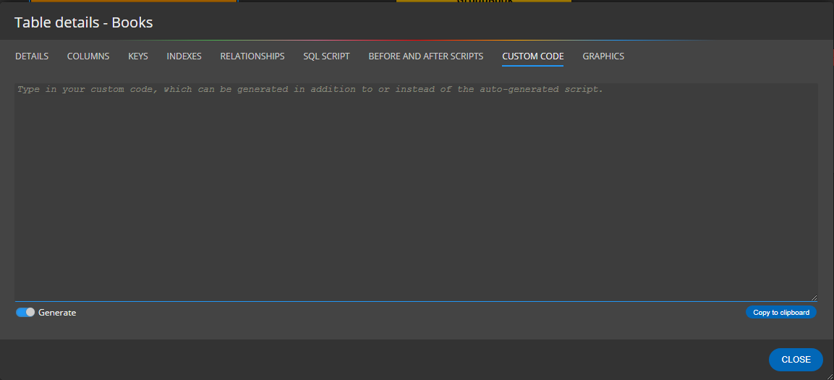
Table properties
creating ER diagrams
in Moon Modeler
Custom code

Slide 32
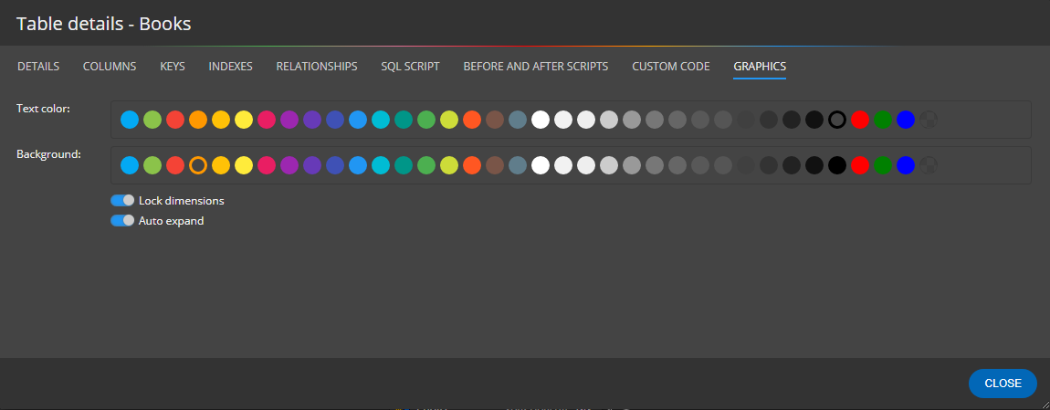
Table properties
creating ER diagrams
in Moon Modeler
Graphics

Slide 33
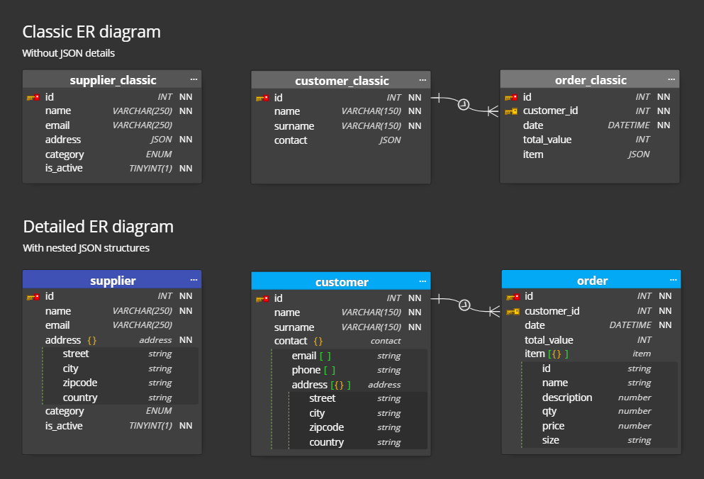
JSON datatypes
creating ER diagrams
in Moon Modeler

Slide 34
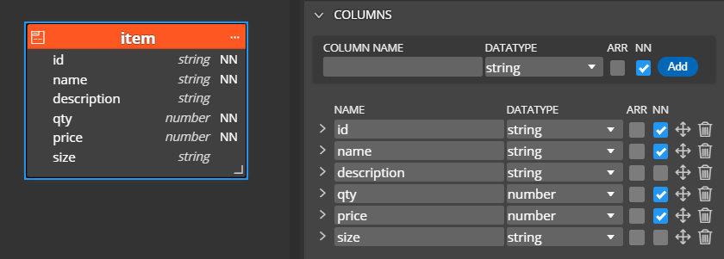
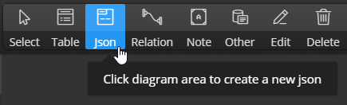
JSON datatypes
creating ER diagrams
in Moon Modeler

Slide 35
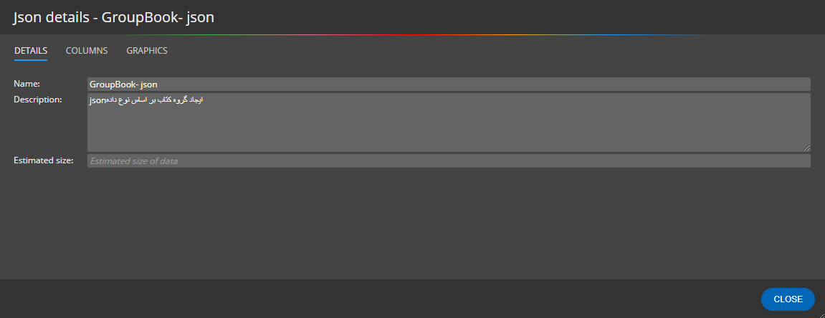
JSON datatypes
creating ER diagrams
in Moon Modeler

Slide 36
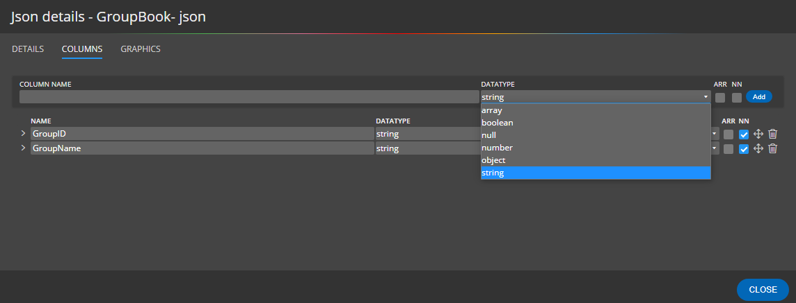
JSON datatypes
creating ER diagrams
in Moon Modeler

Slide 37
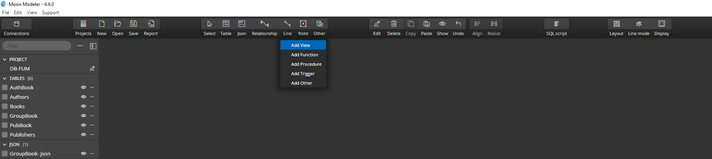
add view

Slide 38
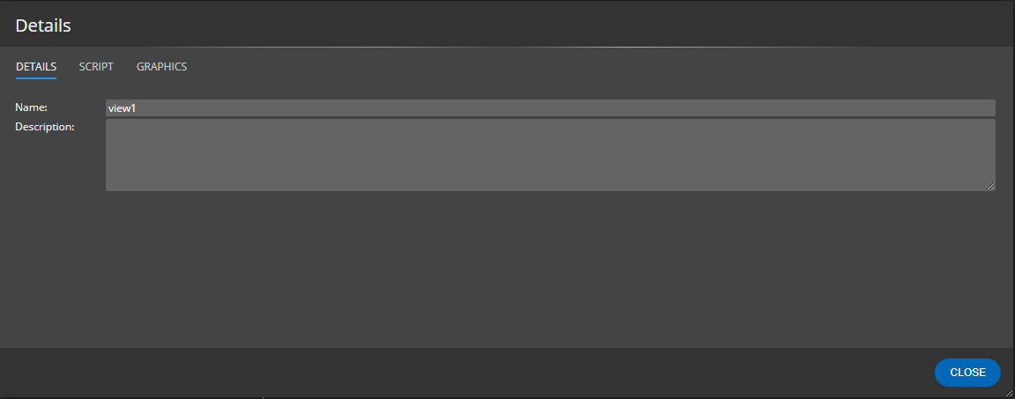
Details
add view

Slide 39
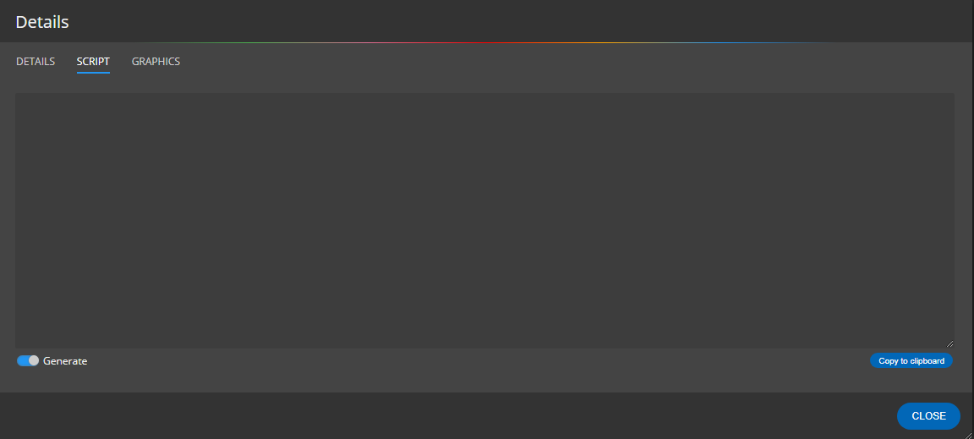
Script
Add view

Slide 40
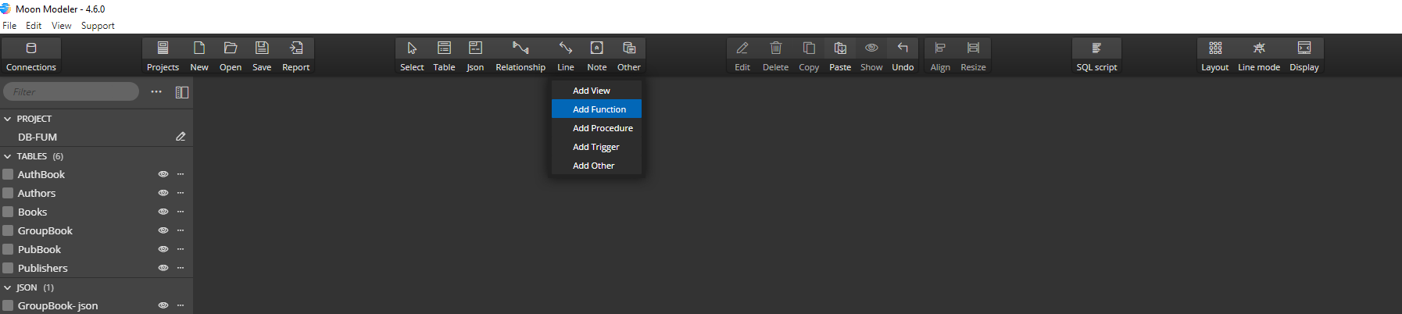
Add function

Slide 41

Details
Add functions

Slide 42
Script
Add functions

Slide 43
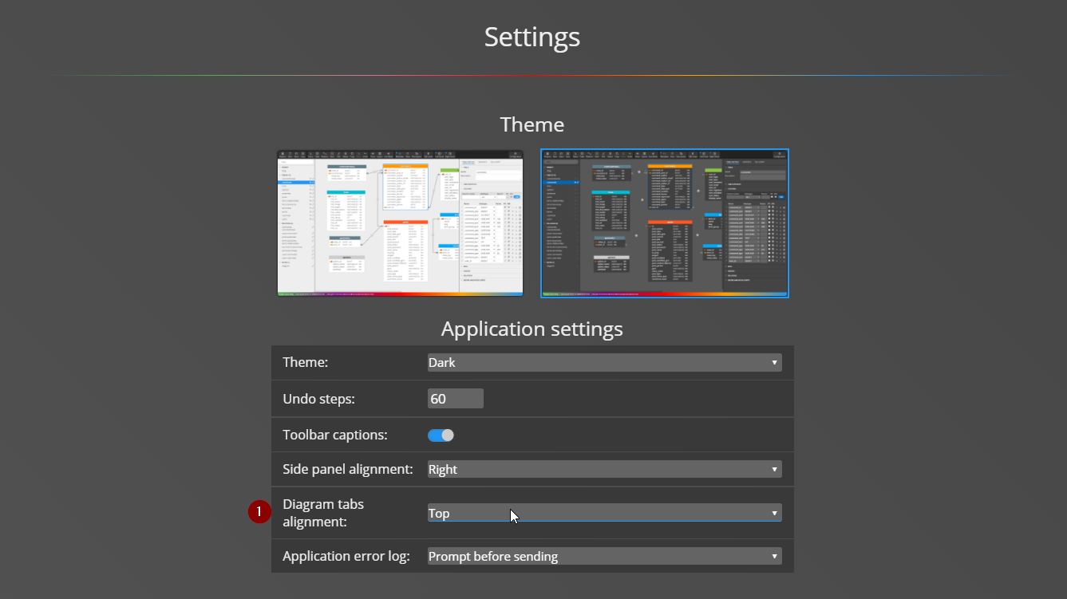
Changing where tabs are displayed in Moon Modeler
creating ER diagrams
in Moon Modeler

Slide 44
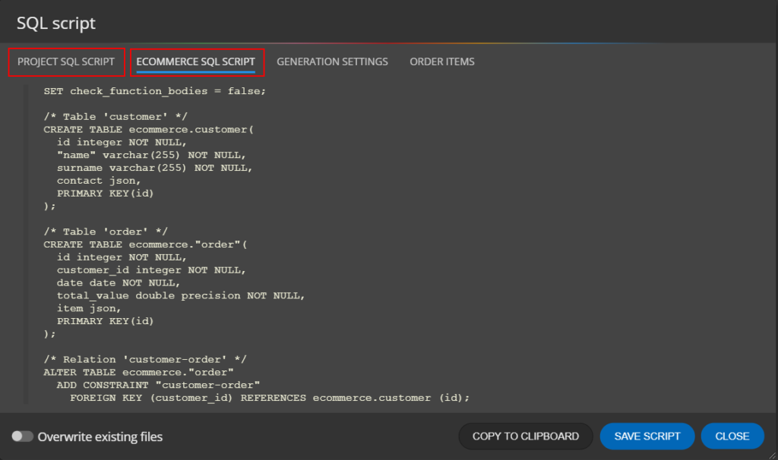
Generating scripts for a diagram
creating ER diagrams
in Moon Modeler

Slide 45
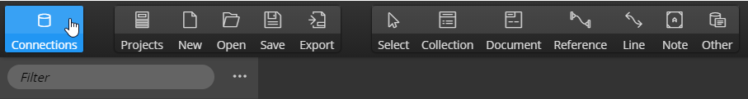
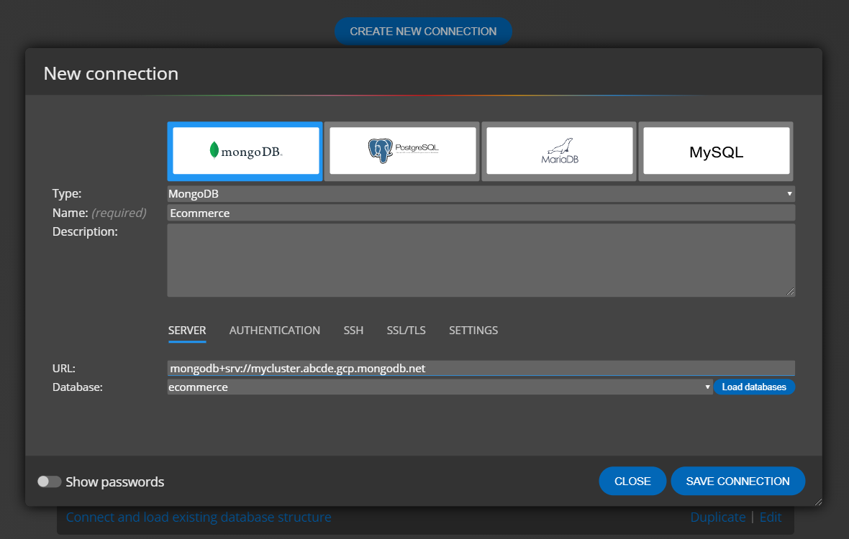
Creating a new database connection(1)
Database connections

Slide 46
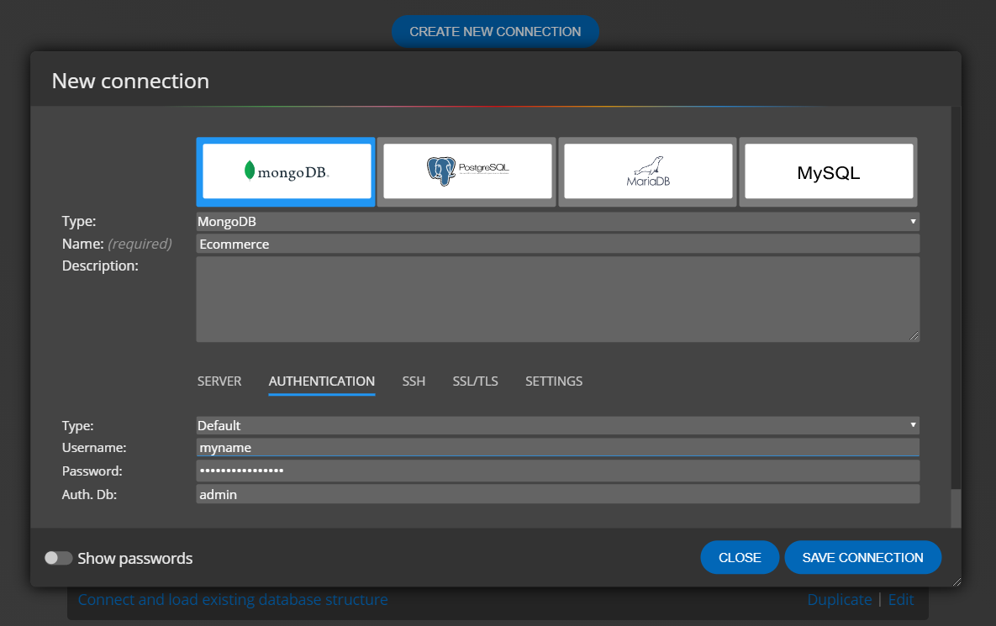
Creating a new database connection(2)
Database connections

Slide 47
Creating a new database connection(3)
Database connections

Slide 48
Database reporting
Key benefits of the generated HTML reports
HTML and SVG format – high quality format of the graphics and lines.
Interactive diagrams – click on any item in the diagram to open the detail.
Searchable pages – click on an object type in the main toolbar to display a list of all objects and use the Search field to filter the items. Then click on an item on the left side to display details instead of all objects.
Easy-to-view – no server required, reports work perfectly in the local environment. Click on the index.html file to view the report. It’s that simple.
Easy-to-share – zip the report and send it to a colleague, or upload the report to your server and then embed the files on your favorite site using the IFRAME tag.

Slide 49
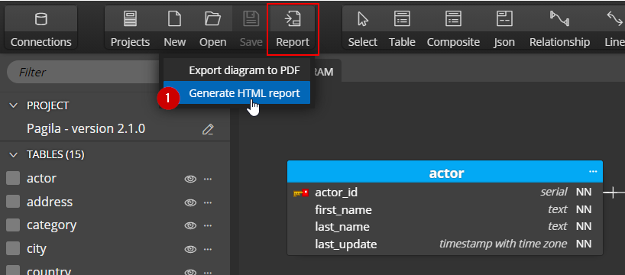
How to create a data model report in Moon Modeler – data modeling and database reporting tool(1)
Database reporting

Slide 50
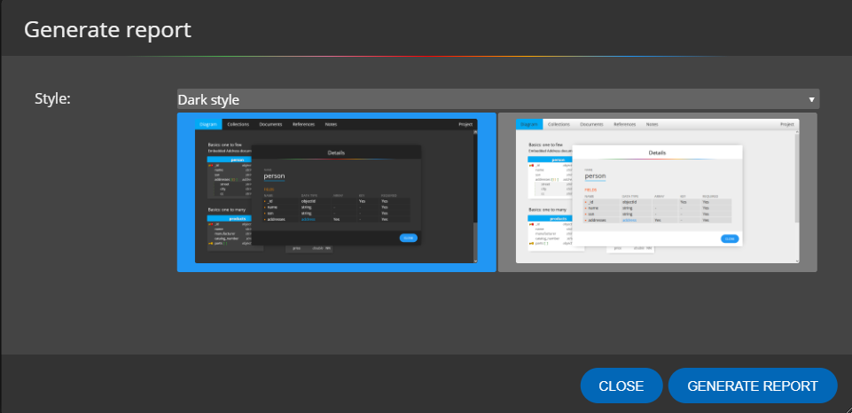
How to create a data model report in Moon Modeler – data modeling and database reporting tool(2)
Database reporting

Slide 51
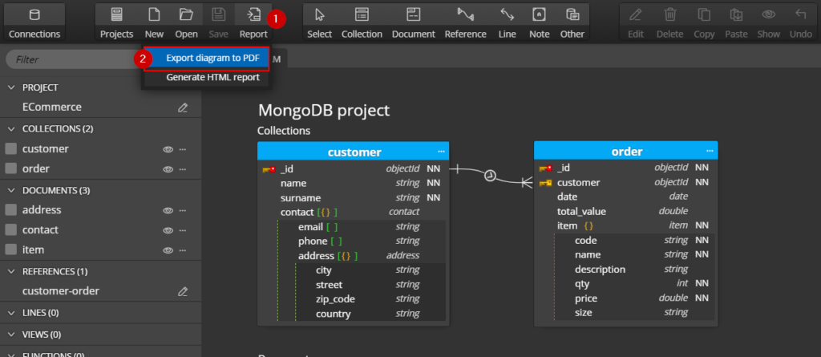
Export ER diagram to PDF
How to export ER diagram to PDF?

Slide 52
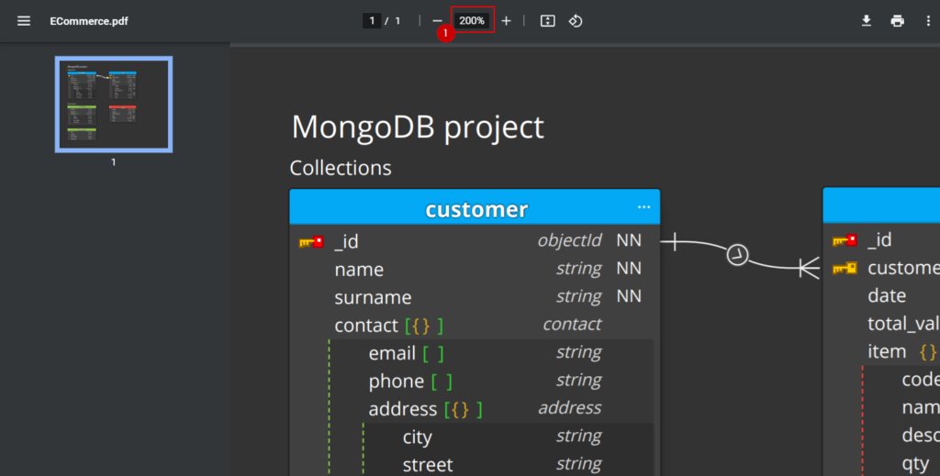
Export ER diagram to PDF
What is the quality of the resulting PDF?

Slide 53
thanks
for your attention

